Slide 1

APEX INSTITUTE OF TECHNOLOGY
DEPARTMENT OF COMPUTER SCIENCE & ENGINEERING
Computer Organization & Architecture (21CSH-281)
Faculty: Siddharth Kumar (E12853)
Lecture - 11
Computer Arithmetic: Ripple Carry Adder and Carry Look-ahead Adder
DISCOVER . LEARN . EMPOWER

Slide 2
Computer Organization & Architecture: Course Objectives
COURSE OBJECTIVES
The course aims to:
The purpose of the course is to introduce principles of computer organization and the basic architectural concepts.
It begins with basic organization, design, and programming of a simple digital computer and introduces simple register transfer language to specify various computer operations.
Topics include computer arithmetic, instruction set design, microprogrammed control unit, pipelining and vector processing, memory organization and I/O systems, and multiprocessors.
To familiarize Students with the detailed Architectures of a Central Processing Unit.
Learn the different types of serial communication techniques.

Slide 3
COURSE OUTCOMES
On completion of this course, the students shall be able to:-
CO1 | Identify and interpret the basics of instruction sets and their impact on the design, organization, and functionality of various functional units of a computer comparable to the CPU, memory organization, I/O organization, and parallel processors.
CO2 | Analysis of the design of arithmetic & logic unit and understanding of the fixed point and floating-point arithmetic operations.
CO3 | Relate cost performance and design trade-offs in designing and constructing a computer processor which includes memory.
CO4 | Understanding the different ways of communicating with I/O devices and standard I/O interfaces.
CO5 | Implementation of control unit techniques and the concept of Pipelining.

Slide 4
What is Adder ?
An adder is a digital circuit that performs addition of numbers.
The most common adders are operated on binary numbers.
In processor it is used to calculate addresses, table indices, and similar operations.

Slide 5
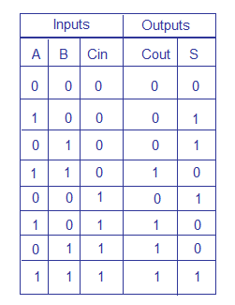
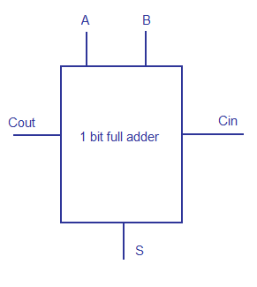
Full Adder
Full adder is a logic circuit that adds two input operand bits plus a Carry in bit and outputs a Carry out bit and a sum bit.
The Sum out (S_{out}) of a full adder is the XOR of input operand bits A, B and the Carry in (C_{in}) bit.

Slide 6
Ripple Carry Adder- Introduction
The ripple carry adder is constructed by
cascading full adder blocks in series
The carryout of one stage is fed directly to the carry-in of the next stage
This adder is called a ripple carry adder because each carry bit gets rippled into the next stage.
For an n-bit ripple adder, we require n full
adders

Slide 7
Ripple Carry Adder
Propagation delays inside the logic circuitry is the reason behind this
Propagation delay is time elapsed between the application of an input and occurance of the corresponding output.
Consider a NOT gate, The time taken for the NOT gate’s output to become “0” after the application of logic “1” to the NOT gate’s input is the propagation delay here.
Similarly the carry propagation delay is the time elapsed between the application of the carry in signal and the occurance of the carry out (C_{out}) signal.

Slide 8

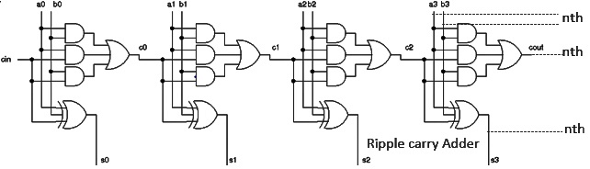

Ripple Carry Adder-Circuit Diagram
Img source: https://www.researchgate.net/profile/Harshil_Goyal2/publication/306284009/figure/fig1/AS:396637412315138@1471577136832/Benchmark-circuit-structure-an-n-bit-ripple-carry-adder.png

Slide 9
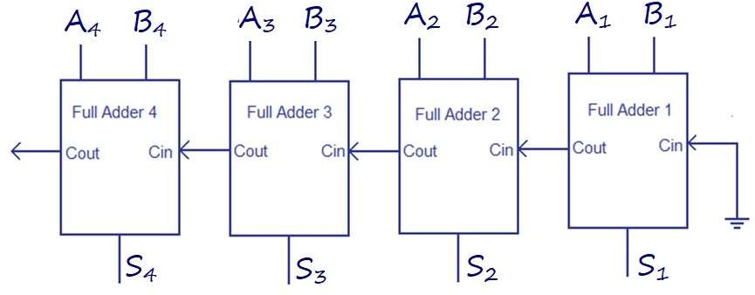
Ripple Carry Adder-Logic Diagram
Image source:https://www.circuitstoday.com/wp-content/uploads/2012/03/ripple-carry-adder.png

Slide 10
Ripple Carry Adder-Truth Table
A₁ | A₂ | A₃ | A₄ | B₄ | B₃ | B₂ | B₁ | S₄ | S₃ | S₂ | S₁ | Carry
0 | 0 | 0 | 0 | 0 | 0 | 0 | 0 | 0 | 0 | 0 | 0 | 0
0 | 1 | 0 | 0 | 0 | 1 | 0 | 0 | 1 | 0 | 0 | 0 | 0
1 | 0 | 0 | 0 | 1 | 0 | 0 | 0 | 0 | 0 | 0 | 0 | 1
1 | 0 | 1 | 0 | 1 | 0 | 1 | 0 | 0 | 1 | 0 | 0 | 1
1 | 1 | 0 | 0 | 1 | 1 | 0 | 0 | 1 | 0 | 0 | 0 | 1
1 | 1 | 1 | 0 | 1 | 1 | 1 | 0 | 1 | 1 | 0 | 0 | 1
1 | 1 | 1 | 1 | 1 | 1 | 1 | 1 | 1 | 1 | 1 | 0 | 1

Slide 11
Ripple Carry Adder-Applications
These carry adders are used mostly in addition to n-bit input sequences.
These carry adders are applicable in the digital signal processing and microprocessors.

Slide 12
Carry look-ahead adder
The ripple-carry adder, its limiting factor is the time it takes to propagate the carry.
The carry look-ahead adder solves this problem by calculating the carry signals in advance, based on the input signals.
The result is a reduced carry propagation time.
The Propagate P and generate G in a full-adder, is given as:
Pi = Ai ⊕ Bi Carry propagate
Gi = AiBB i Carry generate

Slide 13
both propagate and generate signals depend only on the input bits and thus will be valid after one gate delay.
The new expressions for the output sum and the carryout are given by:
Si = Pi ⊕ Ci-1
Ci+1= Gi + PiCi
These equations show that a carry signal will be generated in two cases:
1) if both bits Ai and Bi are 1
2) if either Ai or Bi is 1 and the carry-in Ci is 1.

Slide 14
Apply these equations for a 4-bit adder:
C1 = G0 + P0C0
C2 = G1 + P1C1 = G1 + P1(G0 + P0C0) = G1 + P1G0 + P1P0C0
C3 = G2 + P2C2 = G2 + P2G1 + P2P1G0 + P2P1P0C0
C4 = G3 + P3C3 = G3 + P3G2 + P3P2G1 + P3P2P1G0 + P3P2P1P0C0

Slide 15
These expressions show that C2, C3 and C4 do not depend on its previous carry-in.
Therefore C4 does not need to wait for C3 to propagate. As soon as C0 is computed, C4 can reach steady state.
The same is also true for C2 and C3
The general expression is Ci+1= Gi + PiGi-1 + PiPi-1Gi-2 + ……. PiPi-1….P2P1G0 + PiPi-1 ….P1P0C0.

Slide 16
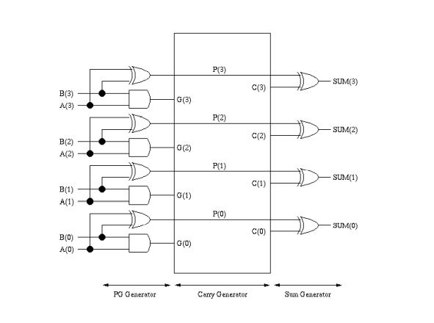

Slide 17
Summary
Discussed about Ripple carry adder.
Carry look ahead adder.
Assessment Questions
Q1. How is ripple carry adder calculated?
Q2. Which adder works faster than ripple carry adder?

Slide 18
THANK YOU

